Slide 1
Hertfordshire
Herts School Games Organisers

Slide 2
The Great Big Green Week 2022
24th September – 2nd October
There are various educational resources available on the GBGW website and the Hertfordshire School Games Organisers have provided some additional physical activity ideas for your school to try
Eco Warriors
Active Travel
Litter Picks
Nature Walks
Recycling Relays
Hertfordshire

Slide 3
Eco Warriors
The School Games launched the new Eco-Friendly Spirit of the Games value last year – encouraging schools and School Games Organisers to deliver events in a more sustainable way
The introduction of the new value also paves the way for the new Eco Friendly Award scheme, which is driven by young leaders. In Hertfordshire, we will be calling these green young leaders our Eco Warriors
Resources, including a guide for teachers and a booklet to empower young leaders with planning peer-based delivery using their local environment are now available to download
#OurEcoEvent

Slide 4
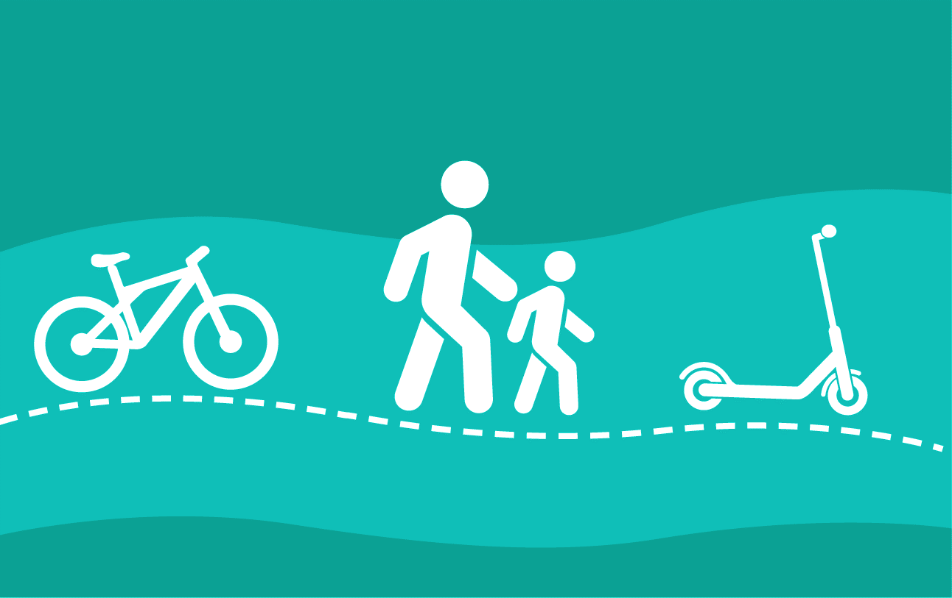
Active Travel
Increase physical activity, reduce congestion and improve safety around the school through the promotion of Active Travel
Cycle
Walk
Scoot
You can use the 60 Active Minutes resources to assess how pupils currently travel to and from school
Promote more active travel through the infographic and activity tracker

Slide 5
Litter Picks
Litter is a big issue in the UK, with more than two million pieces of litter being dropped daily
Why not organise a litter pick around your school grounds
A whole school assembly is a good way of introducing the topic of litter and there are cross-curricular links that can be used in lessons throughout GBGW
Some councils have produced thorough guides on how to organising litter picks in schools
Stop the Drop
The Little Pickers
Litter Patrol
Curriculum Links
English
Maths
Science
Art & Design
Physical Education
Computing
Geography

Slide 6
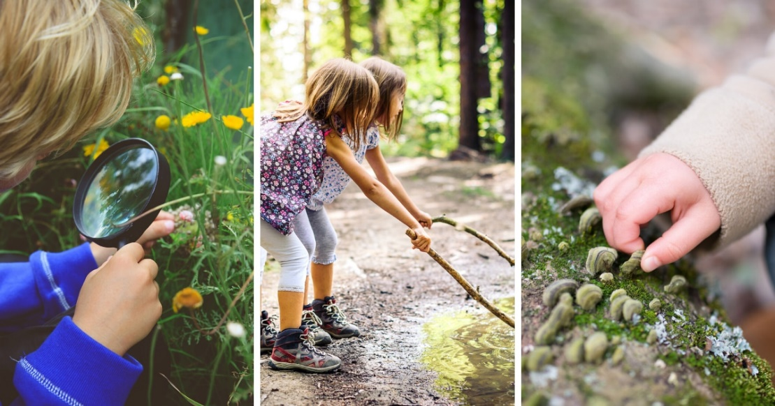
Nature Walks
Take learning outside and have children interact with their environment
Nature walks are a fun and easy way to bring your students outdoors, whether it’s on the school grounds, in your backyard, or at a park or another local place of interest
Here are a few ideas to get you started
Scavenger hunt / nature bingo (example)
Collect art supplies to create a nature piece of art back at school
Visit a local nature reserve or conservation area
Plant trees or create wildlife areas in school (flowers, bee friendly plants, bug hotels, etc.)
Play I spy outside, describing things around you
Have a picnic

Slide 7
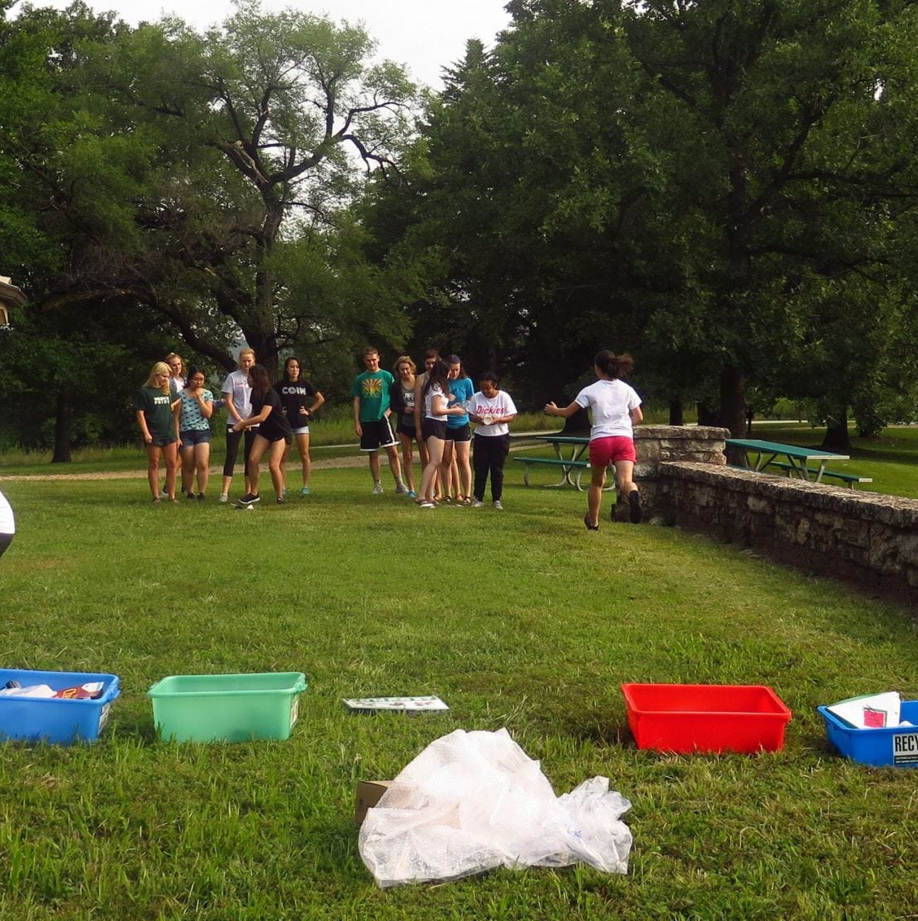
Recycling Relays
Have a pile of different materials and split the class into teams and organise relay races to sort as many items as possible in the time limit
Paper / Cardboard
Plastic
Glass
Metal
Organic
Not recyclable

Slide 8
Share
Let us know what you’ve been up to for the Great Big Green Week 2022
Tweet and tag us in your posts
@Herts_SGOs
Or contact your local School Games Organiser - find their email on the link below
Hertfordshire School Games Organisers

